Slide 1
GOSPEL OF JOHN
John 1:38–51
The Disciples’ Testimony Concerning Jesus
Come and see · Stacked confessions · Heaven opened
Core content based on John MacArthur’s Exposition of John

Slide 2
FROM LAST WEEK
The witness now moves from the river to the first followers
Day 1–3
Purpose unchanged
Tonight
John the Baptist: He is here. Look at Him. Follow Him. Two of his own disciples leave him for Jesus.
John the gospel writer still aims to prove to you that Jesus is the Christ, the Son of God — that believing, you may have life in his name.
First-person testimony. Messiah. The One Moses and the Prophets wrote. Son of God. King of Israel. Heaven open on the Son of Man.
Last week ended at 1:37 · John 20:31

Slide 3
THE DAYS
Four days in John 1:19–51
Day | Text | What happens
1 | 1:19–28 | Delegation — He is here
2 | 1:29–34 | The crowd — Look at Him: Lamb, Spirit, Son
3 | 1:35–42 | Two disciples follow. Andrew finds Peter.
4 | 1:43–51 | Jesus finds Philip. Philip finds Nathanael.
John is precise with “the next day.” The unnamed disciple is almost certainly the writer.

Slide 4
FIRST CONTACT
This is not the calling of the Twelve
What it is
First examination. They spend hours with Him. They confess who He is. John includes it because it serves 20:31.
Who they are
Galilean fishermen who already sat under John’s preaching of sin, wrath, repentance, and the Lamb.
What they are not
They are not yet looking first for a political king. They are looking for the sacrifice the Scriptures promised.
How He chooses
He does not scour the nation for nobles. He takes men from one fishing village and turns them into the core of the apostolic witness.
1 Corinthians 1:26–29 · not many noble

Slide 5
THE TEXT
John 1:38–42
Jesus turned and saw them following and said to them, “What are you seeking?” And they said to him, “Rabbi” (which means Teacher), “where are you staying?” He said to them, “Come and you will see.” So they came and saw where he was staying, and they stayed with him that day, for it was about the tenth hour.
One of the two who heard John speak and followed Jesus was Andrew, Simon Peter’s brother. He first found his own brother Simon and said to him, “We have found the Messiah” (which means Christ). He brought him to Jesus. Jesus looked at him and said, “You are Simon the son of John. You shall be called Cephas” (which means Peter).
John 1:38–42 ESV · biblegateway.com/passage/?search=John+1:38-42&version=ESV

Slide 6
DAY THREE · GROUP ONE
What are you seeking?
The question
Rabbi, where are you staying?
He does not first ask who they are. He asks what they want. They are still John’s disciples (1:35, 37).
They want time. Rabbi means Teacher. They know there is more than a sentence at the river.
Come, and you will see
The tenth hour
Invitation to fellowship and learn from him. Accessibility. The lodging is unnamed and likely humble.
About 4 p.m. They stay the rest of the day — and likely the night. The gospel writer John never forgot the hour.
They have changed teachers. John pointed. Jesus now teaches.

Slide 7
DAY THREE
We have found the Messiah
Andrew’s sentence
He brought him
Cephas / Peter
No hesitation. First-person, likely after hours of questions. Messiah (Hebrew) — John translates Christ: the Anointed One.
Andrew will live as “Simon Peter’s brother,” but he is the first called. His instinct is to bring someone else.
Jesus knows who Simon is and what he will become: stone. Not yet Pentecost. A long road. Omniscience plus prophecy in one greeting.
Emmaus parallel: Moses and the Prophets opened — at the beginning as at the end (Luke 24).

Slide 8
THE TEXT
John 1:43–46
The next day Jesus decided to go to Galilee. He found Philip and said to him, “Follow me.” Now Philip was from Bethsaida, the city of Andrew and Peter. Philip found Nathanael and said to him, “We have found him of whom Moses in the Law and also the prophets wrote, Jesus of Nazareth, the son of Joseph.” Nathanael said to him, “Can anything good come out of Nazareth?” Philip said to him, “Come and see.”
John 1:43–46 ESV · biblegateway.com/passage/?search=John+1:43-46&version=ESV

Slide 9
DAY FOUR · GROUP TWO
Jesus finds Philip
Initiative flips
Follow Me
Andrew and John followed. Now Jesus finds. He purposed to go to Galilee and found Philip.
Said some twenty times in the Gospels. Not a moment. A life. Come after Me.
Philip’s sentence
Come and see
Not only Messiah: the One Moses in the Law and the Prophets wrote. The confession is real and not yet complete — “son of Joseph,” “of Nazareth.”
Nathanael scorns the town. Philip does not argue geography but bears witness and invites.
Bethsaida = house of fishing. The same small village. “Follow Me” is present and ongoing.

Slide 10
THE TEXT
John 1:47–51
Jesus saw Nathanael coming toward him and said of him, “Behold, an Israelite indeed, in whom there is no deceit!” Nathanael said to him, “How do you know me?” Jesus answered him, “Before Philip called you, when you were under the fig tree, I saw you.” Nathanael answered him, “Rabbi, you are the Son of God! You are the King of Israel!”
Jesus answered him, “Because I said to you, ‘I saw you under the fig tree,’ do you believe? You will see greater things than these.” And he said to him, “Truly, truly, I say to you, you will see heaven opened, and the angels of God ascending and descending on the Son of Man.”
John 1:47–51 ESV · biblegateway.com/passage/?search=John+1:47-51&version=ESV

Slide 11
DAY FOUR
An Israelite indeed
No deceit
The fig tree
The confession
Contrast Jacob the deceiver. Nathanael is a real believer in the true God — not the hostile establishment of 1:19. Jesus reads the heart.
“Before Philip called you, I saw you.” Not line of sight. Heart and location. Omniscience. He saw him when eyes could not.
Rabbi. Son of God. King of Israel. Deity and the promised ruler, spoken by a fisherman from Cana.
“Son of God” as a Hebraism: same nature. Not merely an office.

Slide 12
GREATER THINGS
Heaven opened on the Son of Man
You will see greater things
This is only the beginning. The ministry they are about to watch will outrun a private insight.
Truly, truly
First of about twenty-five times in John. Solemn, not casual.
Jacob’s ladder
Genesis 28: angels ascending and descending, and the Lord is present. Jesus says He is that meeting place. The traffic between God and man runs through Him.
Son of Man
Daniel 7:13–14. Jesus’ most frequent self-title. Dominion given. Humiliation and glory in one name.
Genesis 28 · Daniel 7:13–14 · biblegateway.com/passage/?search=Genesis+28&version=ESV

Slide 13
THE STACK
Titles now on the table
Lamb of God
Son of God
who takes away the sin of the world
Baptist at the river; Nathanael at the end
He who baptizes
King of Israel
with the Holy Spirit
the promised ruler
Messiah / Christ
Son of Man
Andrew, after the night
heaven open — Jacob’s ladder
The One written
Moses and the Prophets — Philip
John 20:31 is already being spoken by fishermen.

Slide 14
HOW SALVATION LOOKS HERE
Seeking soul · Seeking Savior · Seeking saint
A seeking soul
A seeking Savior
A seeking saint
“What are you seeking?” They stay. They ask. They come and see.
He turns. He says Come. He finds Philip. He sees Nathanael before Philip does. Initiative is His.
Andrew finds Peter. Philip finds Nathanael. The first instinct of a new disciple is to bring someone else: We have found Him. Come and see.
Do not stop at knowing the titles. Follow. Then speak.

Slide 15
THE TEXT
Son of Man — Daniel 7:13–14
I saw in the night visions, and behold, with the clouds of heaven there came one like a son of man, and he came to the Ancient of Days and was presented before him. And to him was given dominion and glory and a kingdom, that all peoples, nations, and languages should serve him; his dominion is an everlasting dominion, which shall not pass away, and his kingdom one that shall not be destroyed.
Daniel 7:13–14 ESV · biblegateway.com/passage/?search=Daniel+7:13-14&version=ESV

Slide 16
THE TEXT
Jacob’s Ladder — Genesis 28:10–17
Jacob left Beersheba and went toward Haran. And he came to a certain place and stayed there that night, because the sun had set. Taking one of the stones of the place, he put it under his head and lay down in that place to sleep.
And he dreamed, and behold, there was a ladder set up on the earth, and the top of it reached to heaven. And behold, the angels of God were ascending and descending on it! And behold, the Lord stood above it and said, “I am the Lord, the God of Abraham your father and the God of Isaac… and in you and your offspring shall all the families of the earth be blessed…
Then Jacob awoke from his sleep and said, “Surely the Lord is in this place, and I did not know it.” And he was afraid and said, “How awesome is this place! This is none other than the house of God, and this is the gate of heaven.”
Genesis 28:10–17 ESV · biblegateway.com/passage/?search=Genesis+28:10-17&version=ESV

Slide 17
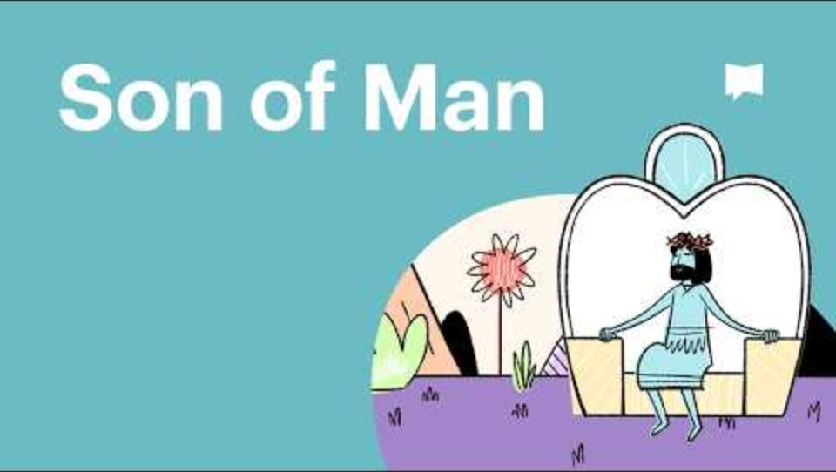
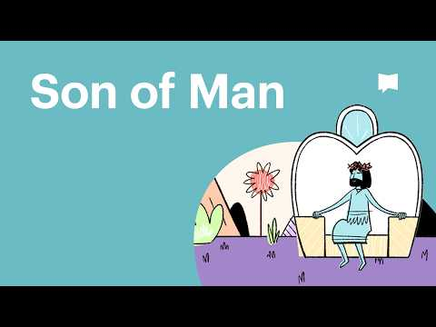
VIDEO
Why Jesus Called Himself the Son of Man
Bible Project
Jesus’ own title, Son of Man — Daniel 7 and the human one who overcomes evil. Fits John 1:51.
youtu.be/z6cWEcqxhlI
Play on YouTube
Click the preview or the link · youtu.be/z6cWEcqxhlI

Slide 18
FOR THE TABLE
Do not stop at the titles
1. Jesus’ first question is “What are you seeking?” What are you actually after — a king of your own making, or the Lamb?
2. Where are you still arguing “Can anything good come from…?” instead of coming to see?
3. Andrew and Philip do not win the argument. They issue an invitation. Whom do you need to bring with “Come and see”?
4. Nathanael believed because Jesus knew him. Jesus says greater things are coming. What would it mean to stay for those?
5. Heaven open on the Son of Man: do you treat Jesus as a teacher only, or as the one place God and man meet?
Knowing is not yet following. Following is not yet bringing.

Slide 19
CLOSE
What follows
John 2
The first of the signs. Water into wine at Cana. His mother. His hour. He manifested his glory, and his disciples believed in him.
Memory — the invitation
“Come and you will see.”
— John 1:39 ESV
Next in the series: John 2 · the first sign

