Slide 1
GOSPEL OF JOHN
John 2:18–25
Deity on Display
The sign · The body · The hearts
Core content based on John MacArthur’s Exposition of John · GTY 43-10

Slide 2
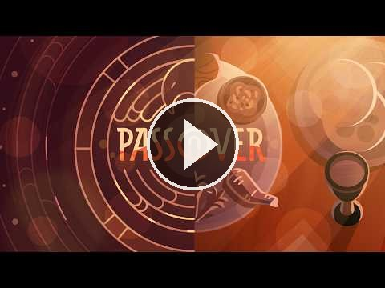
VIDEO
Passover — Bible Project
Bible Project
The feast that frames this Passover. The lamb, the blood, and the protection in the word pasach.
Play on YouTube
youtu.be/14x_PtlnJHw
Click the preview · opens on YouTube

Slide 3
WHERE WE ARE
The rest of the first Passover
Last week
This week
Next
John 2:12–17
John 2:18–25
John 3:1–3
The house purged. Zeal for the Father.
The sign of the body. He knows what is in man.
Nicodemus. “You must be born again.” GTY 43-11.
Chapter 2 closes here. Chapter 3 begins at 43-11.

Slide 4
FROM LAST WEEK
He has already claimed the house
John 2:12–17
The question they ask
Passover. The Court of the Gentiles has been made into a market.
A whip of cords. Was it just the merchants and their animals, or did they all leave?
“Do not make my Father’s house a house of trade.”
Psalm 69:9 — his disciples recognize the prophecy that his zeal would consume him.
Not “what is wrong?”
“What sign do you show us for doing these things?”
He doesn’t give them credentials. He gives them a resurrection.
John 2:16–18 ESV · biblegateway.com

Slide 5
THE TEXT
John 2:18–22
So the Jews said to him, “What sign do you show us for doing these things?” Jesus answered them, “Destroy this temple, and in three days I will raise it up.”
The Jews then said, “It has taken forty-six years to build this temple, and will you raise it up in three days?”
But he was speaking about the temple of his body. When therefore he was raised from the dead, his disciples remembered that he had said this, and they believed the Scripture and the word that Jesus had spoken.
John 2:18–22 ESV · biblegateway.com

Slide 6
THE SIGN
Destroy this temple
What they hear
What He means
Herod’s temple. Forty-six years.
Stones, courts, a building still unfinished.
A boast they mock.
The temple of His body.
They will destroy it. He will raise it.
The meeting place of God and man will no longer be a building.
John 2:19–21 ESV · biblegateway.com

Slide 7
THE DEMAND
“What sign do you show us?”
The leaders do not repent for making the Temple a market. They ask for a sign.
Matthew 12:39 — an evil and adulterous generation seeks a sign. They will receive the sign of Jonah.
His accusers will use the saying about the destruction and raising of the Temple, twisted, at the trial and at the cross.
He will not do a trick to convince them of his authority.
The sign He gives will be His death and His rising.
Matthew 12:39–40 · biblegateway.com

Slide 8
THREE DAYS
He names the hour before they do
“I will raise it up.” Not “the Father will, and I will watch.”
John 10:18 — He has authority to lay His life down and take it up again.
The sign is not given in the court that afternoon. It is given at the tomb.
They want proof of authority. The proof is a body that does not stay dead.
John 10:17–18 · biblegateway.com

Slide 9
AFTERWARD
They remembered — after He was raised
The disciples do not understand this in the courtyard.
When He is raised, they remember the saying.
They believed the Scripture and the word Jesus had spoken.
Faith does not necessarily happen in the moment. It is recognition after the sign He named.
John 2:22 ESV · biblegateway.com

Slide 10
THE TEXT
John 2:23–25
Now when he was in Jerusalem at the Passover Feast, many believed in his name when they saw the signs that he was doing.
But Jesus on his part did not entrust himself to them, because he knew all people and needed no one to bear witness about man, for he himself knew what was in man.
John 2:23–25 ESV · biblegateway.com

Slide 11
TWO KINDS OF BELIEF
Many at the feast believed. He did not entrust Himself.
Their belief
His knowledge
Tied to the signs they could see.
A name they were willing to say in the city.
Not yet a life they would lose.
He knew all people.
He needed no character witness.
He knew what was in man.
John 2:23–25 ESV · biblegateway.com

Slide 12
DEITY
The mind that knows the house and the heart
He knows the future of the temple of His body.
He knows the present of every heart in the crowd.
Psalm 139 — searched and known. Isaiah 46 — the end from the beginning.
This is not a shrewd rabbi reading a room. This is the Son who needs no one to tell Him what man is.
Psalm 139:1–4 · Isaiah 46:9–10 · biblegateway.com

Slide 13
SO THAT YOU MAY BELIEVE
Four questions this passage answers
Who is He?
The Son who can raise the temple of His body. The one who knows what is in man.
What did He come to do?
To be destroyed, and in three days to raise that temple. The meeting place of God and man is no longer a building.
What does He offer?
Not a sign on demand. A resurrection. And a knowledge of you that does not need a witness.
How do you receive it?
Not by believing because you saw a sign. The disciples believed the Scripture and the word He had spoken after He was raised.
John 20:31 · biblegateway.com

Slide 14
CLOSE
What follows
John 3:1–3
Memory
A man of the Pharisees, Nicodemus.
“Rabbi, we know that you are a teacher come from God.”
“Unless one is born again he cannot see the kingdom of God.”
GTY 43-11 — Jesus Teaches the Teacher.
“Destroy this temple, and in three days I will raise it up.” He was speaking about the temple of his body. He knew what was in man.
Next in the series: John 3 · Jesus Teaches the Teacher · GTY 43-11

Slide 15
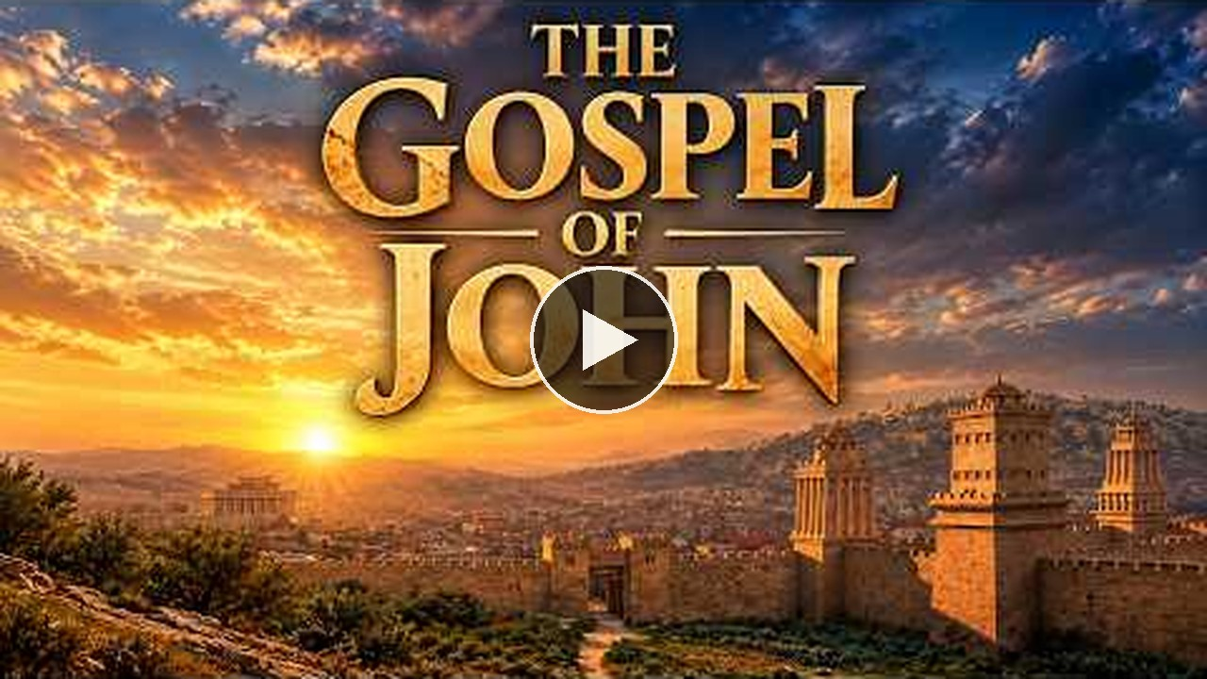
VIDEO
The Gospel of John — Visual Bible
Visual Bible
The challenge after the cleansing. Queued to 18:45.
Play on YouTube
youtu.be/-k0D_qFPb4o?t=1125
Click the preview · starts at 18:45 · opens on YouTube

