Slide 1
GOSPEL OF JOHN
John 3:16–21
For God So Loved the World
Love · The light · The judgment
Core content based on John MacArthur’s Exposition of John · GTY 43-17

Slide 2
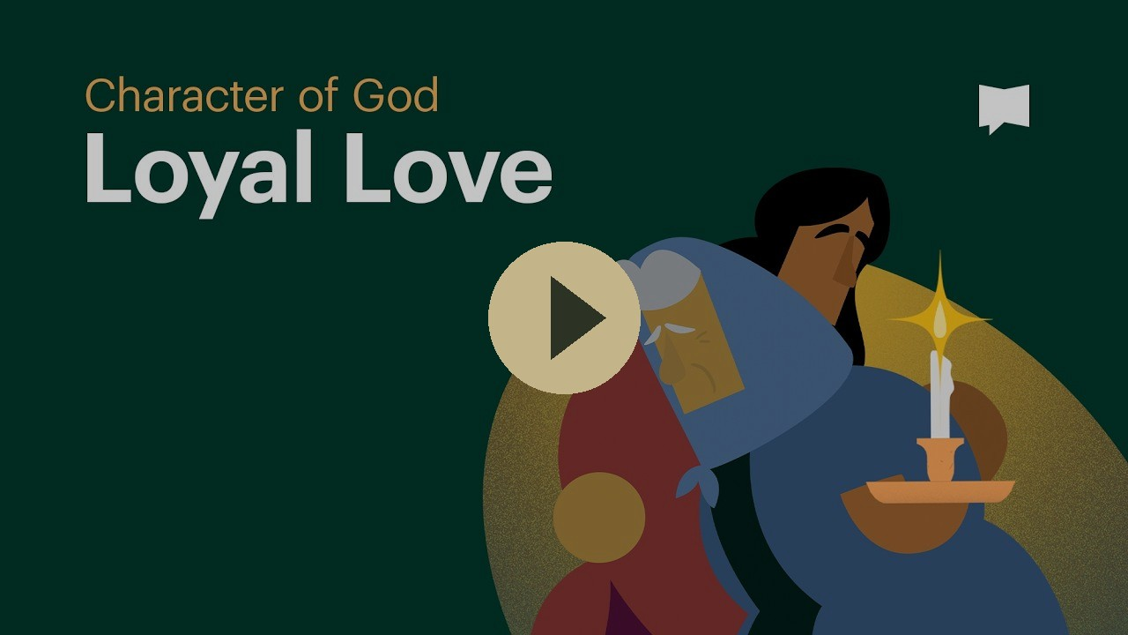
VIDEO
Loyal Love — Bible Project
Bible Project
God’s loyal love for the world. The motive behind the giving of the Son.
Play on YouTube
youtu.be/UfbyFLgs_NM
▶ Play video
Click the preview · opens on YouTube

Slide 3
WHERE WE ARE
The night conversation continues
Two weeks ago
Last week
This week
John 3:1–10
John 3:11–15
John 3:16–21
Born “anothen.”
Water and spirit.
The wind blows where it wishes.
The Son of Man lifted up.
Whoever believes has eternal life.
For God so loved the world.
The light has come.
John 3:1–21 · biblegateway.com

Slide 4
THE TEXT
John 3:16–18
“For God so loved the world, that he gave his only Son, that whoever believes in him should not perish but have eternal life.
For God did not send his Son into the world to condemn the world, but in order that the world might be saved through him.
Whoever believes in him is not condemned, but whoever does not believe is condemned already, because he has not believed in the name of the only Son of God.”
John 3:16–18 ESV · biblegateway.com

Slide 5
THE MOTIVE
For God so loved the world
The motive is love. Not a love limited to Israel only. God loves the world.
He gave His only Son (foreshadowed in the testing of Abraham in Genesis 22:1–2). The purpose is to take on our sins and pay our debt on the cross. The result is eternal life.
Genesis 22:1–2
“After these things God tested Abraham and said to him, ‘Abraham!’ And he said, ‘Here I am.’ He said, ‘Take your son, your only son Isaac, whom you love, and go to the land of Moriah, and offer him there as a burnt offering on one of the mountains of which I shall tell you.’”
Whoever believes shall not perish. The shock is not only “whoever” but the paradigm shift in what is required.
John 3:16 · Genesis 22:1–2 ESV · biblegateway.com

Slide 6
THE PURPOSE
Not to condemn, but to save
God did not send the Son into the world to condemn the world, but that the world might be saved through him.
Christ offers himself to us as a Savior now, but in the afterlife he will be our Judge.
John 5:21–24
“For as the Father raises the dead and gives them life, so also the Son gives life to whom he will. For the Father judges no one, but has given all judgment to the Son, that all may honor the Son, just as they honor the Father. Whoever does not honor the Son does not honor the Father who sent him. Truly, truly, I say to you, whoever hears my word and believes him who sent me has eternal life. He does not come into judgment, but has passed from death to life.”
Whoever believes is not condemned. Whoever does not believe is condemned already. “Already” is the key word, indicating our default state. No future verdict is pending.
John 3:17–18 · John 5:21–24 ESV · biblegateway.com

Slide 7
THE TEXT
John 3:19–21
“And this is the judgment: the light has come into the world, and people loved the darkness rather than the light because their works were evil.
For everyone who does wicked things hates the light and does not come to the light, lest his works should be exposed.
But whoever does what is true comes to the light, so that it may be clearly seen that his works have been carried out in God.”
John 3:19–21 ESV · biblegateway.com

Slide 8
THE LIGHT
People loved the darkness
Jesus, the Son of God, has come into the world, but people prefer to embrace the ungodliness of the world rather than the Creator, because the world encourages their sin and approves of their rebellion.
Everyone who does evil hates the light and does not come to it, otherwise they would have to admit they are wrong and turn from their sin.
The judgment is not that the goodness of the light failed. It is that men preferred the darkness of sin.
John 3:19–20 ESV · biblegateway.com

Slide 9
PARALLEL PASSAGES
Parallel passages in Romans
Romans 3:10–18
None is righteous
Romans 3:20
For by works of the law
Romans 3:23
For all have sinned
Romans 3:27
Our boasting is excluded
Romans 4:19–25
Abraham’s faith and our faith
Romans ESV · biblegateway.com

Slide 10
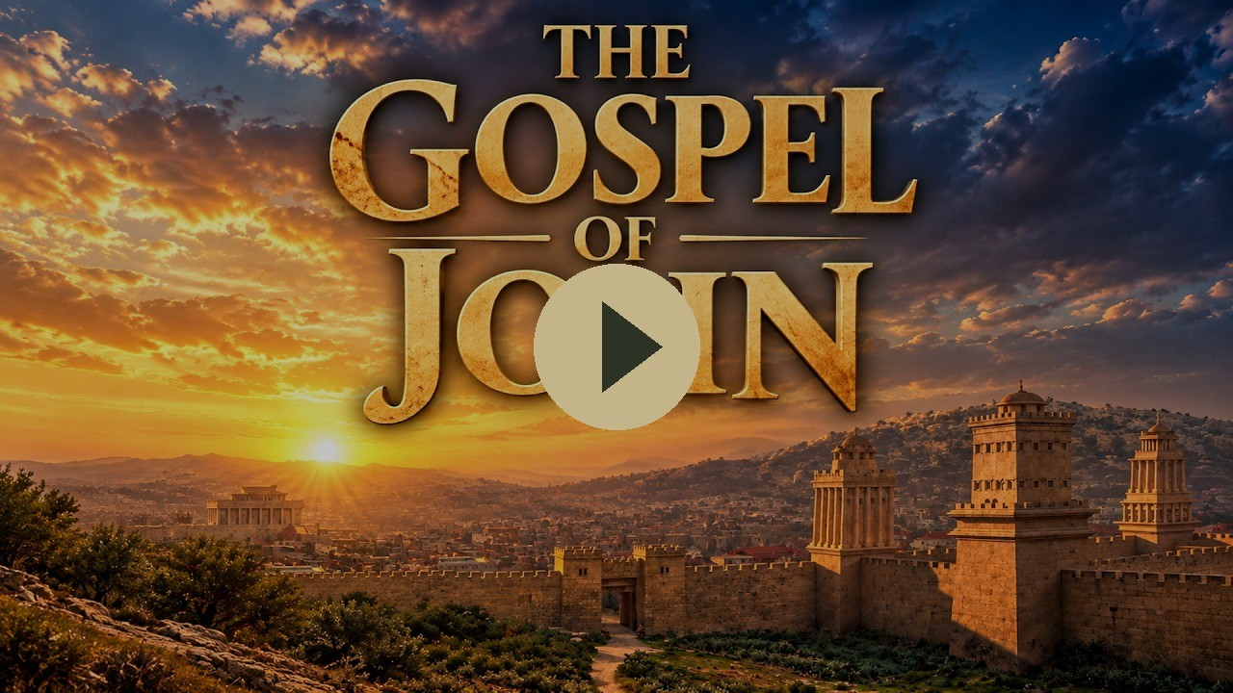
VIDEO
The Gospel of John — Visual Bible
Visual Bible
For God so loved the world. Queued to John 3:16.
Play on YouTube
youtu.be/-k0D_qFPb4o?t=1340
▶ Play video
Click the preview · starts at 22:20 · opens on YouTube

Slide 11
FOR REFLECTION
Questions for the class
1. Does considering the weight of your sin (and who you are sinning against) change your perspective on what Jesus came to do?
2. “Condemned already.” What does it mean that unbelief is not waiting for a future verdict, but is already the default state?
3. People loved the darkness rather than the light. Are there areas in your life where you still prefer the world’s approval of your sin over obedience to God?
4. The shock is not only that anyone can be saved, but the paradigm shift in what God requires from us for salvation. How is belief different from works of the law?
5. Christ offers himself as Savior now… but he will be our Judge later. What difference does that make in how you respond to him today?
John 3:16–21

Slide 12
SO THAT YOU MAY BELIEVE
Four questions this passage answers
Who is He?
The only Son, given. The light that has come into the world.
What did He come to do?
Not to condemn the world, but that the world might be saved through him.
What does He offer?
Eternal life. Whoever believes in him shall not perish.
How do you receive it?
By believing in the name of the only Son of God.
John 20:31 · biblegateway.com

Slide 13
CLOSE
What follows
John 3:22–30
Memory
John the Baptist’s last testimony.
He must increase, I must decrease.
For God so loved the world, that he gave his only Son.
Next in the series: John 3:22–30

